Slide 1
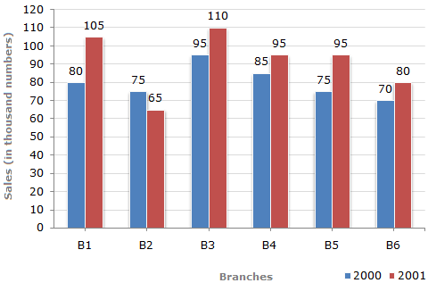
Bar Charts
The bar graph given below shows the sales of books (in thousand number) from six branches of a publishing company during two consecutive years 2000 and 2001.
Sales of Books (in thousand numbers) from Six Branches - B1, B2, B3, B4, B5 and B6 of a publishing Company in 2000 and 2001.

Slide 2
Exercise
What is the ratio of the total sales of branch B2 for both years to the total sales of branch B4 for both years ?
A. | 2:3
B. | 3:5
C. | 4:5
D. | 7:9

Slide 3
Exercise
Total sales of branch B6 for both the years is what percent of the total sales of branches B3 for both the years ?
A. | A) 68.54%
B. | B) 71.11%
C. | C) 73.17%
D. | D) 75.55%

Slide 4
Exercise
What percent of the average sales of branches B1, B2 and B3 in 2001 is the average sales of branches B1, B3 and B6 in 2000 ?
A. | A) 75%
B. | B) 77.5%
C. | C) 82.5%
D. | D) 87.5%

Slide 5
Exercise
What is the average sales of all the branches (in thousand numbers) for the year 2000 ?
. | A) 73
B. | B) 80
C. | C) 83
D. | D) 88

Slide 6
Exercise
Total sales of branches B1, B3 and B5 together for both the years (in thousand numbers) is ?
A. | A) 250
B. | B) 310
C. | C) 435
D. | D) 560

Slide 7
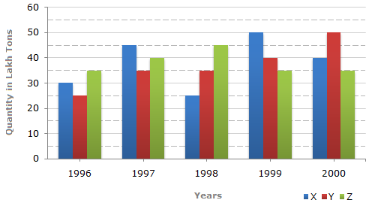
Exercise
The bar graph given below shows the data of the production of paper (in lakh tonnes) by three different companies X, Y and Z over the years.
Production of Paper (in lakh tonnes) by Three Companies X, Y and Z over the Years

Slide 8
Exercise
For which of the following years, the percentage rise/fall in production from the previous year is the maximum for Company Y ?
A. | A) 1997
B. | B) 1998
C. | C) 1999
D. | D) 2000
year | x | y | z | total
1996 | 30 | 25 | 35 | 90
1997 | 45 | 35 | 40 | 120
1998 | 25 | 35 | 45 | 105
1999 | 50 | 40 | 35 | 125
2000 | 40 | 50 | 35 | 125
total | 190 | 185 | 190 | 565

Slide 9
Exercise
What is the ratio of the average production of Company X in the period 1998-2000 to the average production of Company Y in the same period ?
A. | A) 1:1
B. | B) 15:17
C. | C) 23:25
D. | D) 27:29
year | x | y | z | total
1996 | 30 | 25 | 35 | 90
1997 | 45 | 35 | 40 | 120
1998 | 25 | 35 | 45 | 105
1999 | 50 | 40 | 35 | 125
2000 | 40 | 50 | 35 | 125
total | 190 | 185 | 190 | 565

Slide 10
Exercise
The average production for five years was maximum for which company ?
year | x | y | z | total
1996 | 30 | 25 | 35 | 90
1997 | 45 | 35 | 40 | 120
1998 | 25 | 35 | 45 | 105
1999 | 50 | 40 | 35 | 125
2000 | 40 | 50 | 35 | 125
total | 190 | 185 | 190 | 565
A. | A) X
B. | B) Y
C. | C) Z
D. | D) X and Z both

Slide 11
Exercise
In which year was the percentage of production of Company Z to the production of Company Y the maximum ?
A. | A) 1996
B. | B) 1997
C. | C) 1998
D. | D) 1999
year | x | y | z | total
1996 | 30 | 25 | 35 | 90
1997 | 45 | 35 | 40 | 120
1998 | 25 | 35 | 45 | 105
1999 | 50 | 40 | 35 | 125
2000 | 40 | 50 | 35 | 125
total | 190 | 185 | 190 | 565

Slide 12
Exercise
What is the percentage increase in the production of Company Y from 1996 to 1999 ?
A. | A) 30%
B. | B) 45%
C. | C) 50%
D. | D) 60%
year | x | y | z | total
1996 | 30 | 25 | 35 | 90
1997 | 45 | 35 | 40 | 120
1998 | 25 | 35 | 45 | 105
1999 | 50 | 40 | 35 | 125
2000 | 40 | 50 | 35 | 125
total | 190 | 185 | 190 | 565

Slide 13
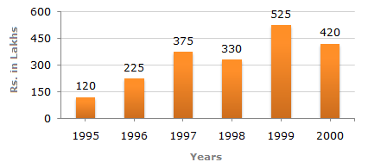
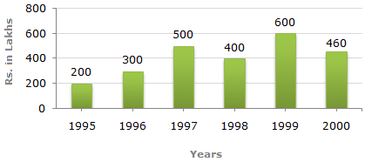
Exercise
Out of the two bar graphs provided below, one shows the amounts (in Lakh Rs.) invested by a Company in purchasing raw materials over the years and the other shows the values (in Lakh Rs.) of finished goods sold by the Company over the years.
Amount invested in Raw Materials Value of Sales of Finished Goods
(Rs. in Lakhs) (Rs. in Lakhs)

Slide 14
Exercise
The maximum difference between the amount invested in Raw materials and value of sales of finished goods was during the year ?
A. | A) 1995
B. | B) 1996
C. | C) 1997
D. | D) 1998

Slide 15
Exercise
The value of sales of finished goods in 1999 was approximately what percent of the sum of amount invested in Raw materials in the years 1997, 1998 and 1999 ?
A. | A) 33%
B. | B) 37%
C. | C) 45%
D. | D) 49%

Slide 16
Exercise
What was the difference between the average amount invested in Raw materials during the given period and the average value of sales of finished goods during this period ?
A. | A) Rs. 62.5 lakhs
B. | B) Rs. 68.5 lakhs
C. | C) Rs. 71.5 lakhs
D. | D) Rs. 77.5 lakhs

Slide 17
Exercise
In which year, the percentage change (compared to the previous year) in the investment on Raw materials is same as that in the value of sales of finished goods ?
A. | A) 1996
B. | B) 1997
C. | C) 1998
D. | D) 1999

Slide 18
Exercise
In which year, there has been a maximum percentage increase in the amount invested in Raw materials as compared to the previous year?
A. | 1996
B. | 1997
C. | 1998
D. | 1999

Slide 19
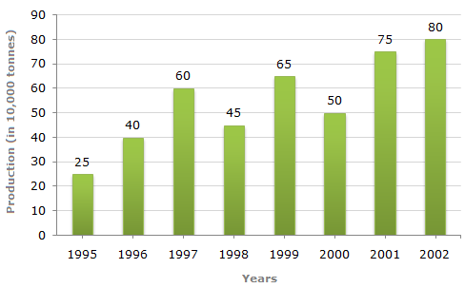
Exercise
Study the bar chart and answer the question based on it.
Production of Fertilizers by a Company (in 10000 tonnes) Over the Years

Slide 20
Exercise
What was the percentage decline in the production of fertilizers from 1997 to 1998 ?
A. | 33(1/3)%
B. | 20%
C. | 25%
D. | 21%

Slide 21
Exercise
The average production of 1996 and 1997 was exactly equal to the average production of which of the following pairs of years?
A. | 2000 and 2001
B. | 1999 and 2000
C. | 1998 and 2000
D. | 1995 and 2001

Slide 22
Exercise
What was the percentage increase in production of fertilizers in 2002 compared to that in 1995?
A. | 320%
B. | 300%
C. | 220%
D. | 200%

Slide 23
Exercise
In which year was the percentage increase in production as compared to the previous year the maximum?
A. | 2002
B. | 2001
C. | 1997
D. | 1996

Slide 24
Exercise
In how many of the given years was the production of fertilizers more than the average production of the given years ?
A. | 1
B. | 2
C. | 3
D. | 4

Slide 25
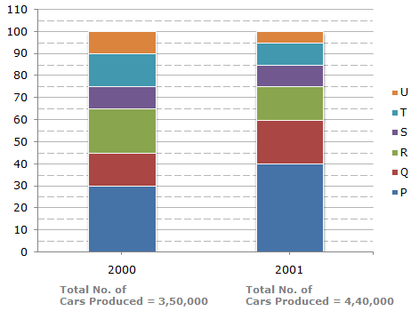
Exercise
The bar graph given below shows the percentage distribution of the total production of a car manufacturing company into various models over two years .
Percentage of Six different types of Cars manufactured by a Company over Two Years

Slide 26
Exercise
What was the difference in the number of Q type cars produced in 2000 and that produced in 2001?
A. | 35,500
B. | 27,000
C. | 22,500
D. | 17,500

Slide 27
Exercise
Total number of cars of models P, Q and T manufactured in 2000 is ?
A. | 2,45,000
B. | 2,27,500
C. | 2,10,000
D. | 1,92,500

Slide 28
Exercise
If the percentage production of P type cars in 2001 was the same as that in 2000, then the number of P type cars produced in 2001 would have been?
A. | 1,40,000
B. | 1,32,000
C. | 1,17,000
D. | 1,05,000

Slide 29
Exercise
If 85% of the S type cars produced in each year were sold by the company, how many S type cars remain unsold?
A. | 7650
B. | 9350
C. | 11,850
D. | 12,250

Slide 30
Exercise
For which model the percentage rise/fall in production from 2000 to 2001 was minimum?
A. | Q
B. | R
C. | S
D. | T

Slide 31
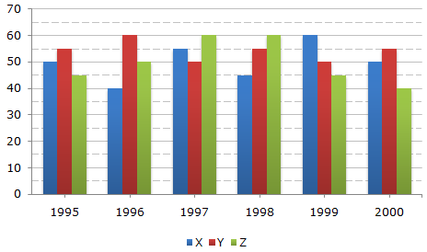
Exercise
A soft drink company prepares drinks of three different flavours - X, Y and Z. The production of three flavours over a period of six years has been expressed in the bar graph provided below.
Production of Three Different Flavours X, Y and Z by a Company over the years (in lakh bottles)

Slide 32
Exercise
The total production of flavour Z in 1997 and 1998 is what percentage of the total production of flavour X in 1995 and 1996?
A. | 96.67%
B. | 102.25%
C. | 115.57%
D. | 133.33%

Slide 33
Exercise
For which flavour was the average annual production maximum in the given period?
A. | X only
B. | Y only
C. | Z only
D. | X and Y

Slide 34
Exercise
What is the difference between the average production of flavour X in 1995, 1996 and 1997 and the average production of flavour Y in 1998, 1999 and 2000?
A. | 50,000 bottles
B. | 80,000 bottles
C. | 2,40,000 bottles
D. | 5,00,000 bottles

Slide 35
Exercise
What was the approximate decline in the production of flavour Z in 2000 as compared to the production in 1998?
A. | 50%
B. | 42%
C. | 33%
D. | 25%

Slide 36
Exercise
For which of the following years the percentage of rise/fall in production from the previous year is the maximum for the flavour Y ?
A. | 1996
B. | 1997
C. | 1998
D. | 1999

Slide 37
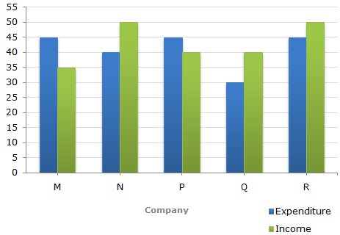
exercise
The following bar graph shows the Income and Expenditures (in million US $) of five companies
in the year 2001. The percent profit or loss of a company is given by
% Profit/Loss = | Income - Expenditure | X 100
 | Expenditure
Income and Expenditure (in million US $) of five companies in the year 2001

Slide 38
exercise
The companies M and N together had a percentage of profit/loss of?
A. | 12% loss
B. | 10% loss
C. | 10% profit
D. | There was no loss or profit

Slide 39
exercise
Total income of Companies M and N together
= (35 + 50) million US $
= 85 million US $
Total expenditure of Companies M and N together
= (45 + 40) million US $
= 85 million US $.
Percent Profit/Loss of companies M and N together
Thus, there was neither loss nor profit for companies M and N together.
% Profit/Loss = |  | 85 - 85 | x 100 |  | = 0%.
 |  | 85

Slide 40
exercise
In 2001, what was the approximate percentage of profit/loss of all the five Companies taken together?
A. | 5% profit
B. | 6.5% profit
C. | 4% loss
D. | 7% loss

Slide 41
exercise
Total income of all five companies
= (35 + 50 + 40 + 40 + 50) million US $
= 215 million US $.
Total expenditure of all five companies
= (45 + 40 + 45 + 30 + 45) million US $
= 205 million US $.
% Profit = |  | (215 - 205) | x 100 |  | % = 4.88% 5%.
 |  | 205

Slide 42
exercise
Which company earned the maximum percentage profit in the year 2001?
A. | M
B. | N
C. | P
D. | Q

Slide 43
exercise
The percentage profit/loss in the year 2001 for various comapanies are:
For M = |  | (35 - 45) | x 100 |  | % = -22.22% i.e., Loss = 22.22%.
 |  | 45
For N = |  | (50 - 40) | x 100 |  | % = 25% i.e., Profit = 25%.
 |  | 40
For Q = |  | (40 - 30) | x 100 |  | % = 33.33% i.e., Profit = 33.33%.
 |  | 30

Slide 44
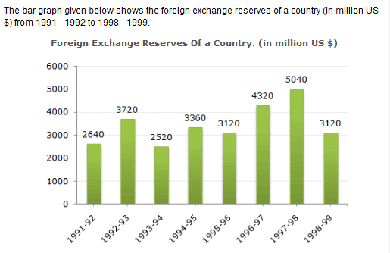

Slide 45


Example
The ratio of the number of years, in which the foreign exchange reserves are above the average reserves, to those in which the reserves are below the average reserves is?

Slide 46
example
The foreign exchange reserves in 1997-98 was how many times that in 1994-95?

Slide 47
example
For which year, the percent increase of foreign exchange reserves over the previous year, is the highest?

Slide 48
example
The foreign exchange reserves in 1996-97 were approximately what percent of the average foreign exchange reserves over the period under review?

Slide 49
example
What was the percentage increase in the foreign exchange reserves in 1997-98 over 1993-94?

